Slide 1

SIGN LANGUAGE CONVERSION INTO TEXT
Under The Guidance of :
Dr. Raju N
By
126004121-Karthick Raja B
126004218-Ramana Guhan G R
126004041-Avinash M

Slide 2
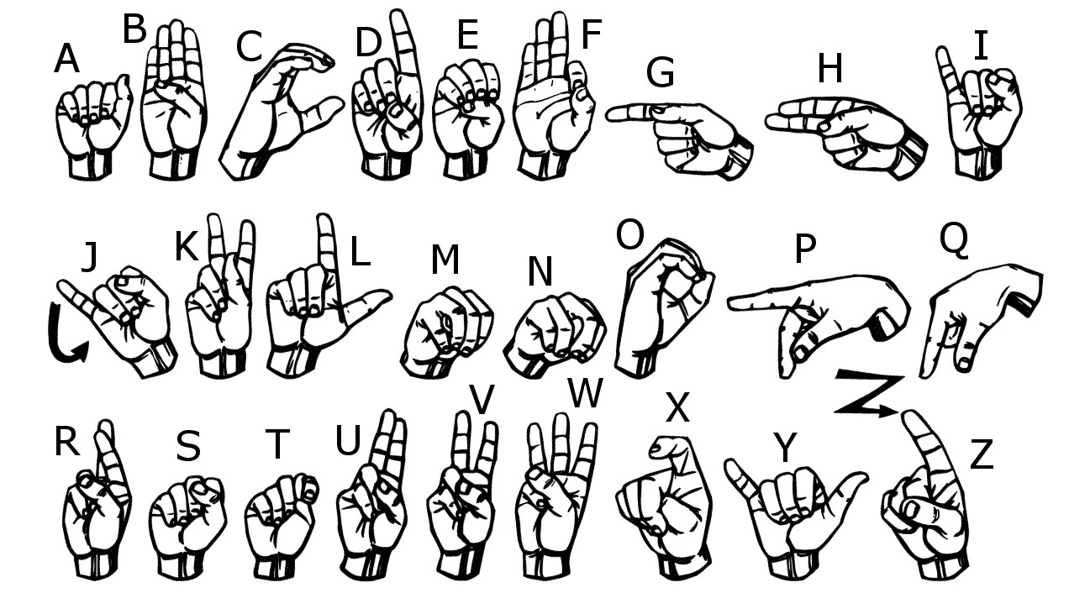
PROBLEM STATEMENT
Communication is the process of exchange of thoughts and messages in various ways such as speech, signals, behavior and visuals.
Deaf and dumb people make use of their hands to express different gestures to express their ideas with other people.
They cannot use spoken languages hence the only way for them to communicate is through sign language.
Therefore, we use American Sign Language(ASL) to convert the sign language into text.

Slide 3
LITERATURE SURVEY
TITLE | INFERENCE
Conversion of sign language into text | Sign to text translation is achieved by pre-processing and hand segmentation , feature extraction , sign recognition and sign to text using MATLAB software.
Sign language into speech conversion and text | Conversion of sign language to text was achieved by FRCNN( Faster Convolutional Neural Networks),YOLO(You Only Look Once) and Mediapipe.
Real time conversion of sign language to text and speech , vice versa | Using CNN ( Convolutional Neural Network) ,image processing , animation gesture recognition to achieve accurate and efficient translation between sign language and spoken language.

Slide 4
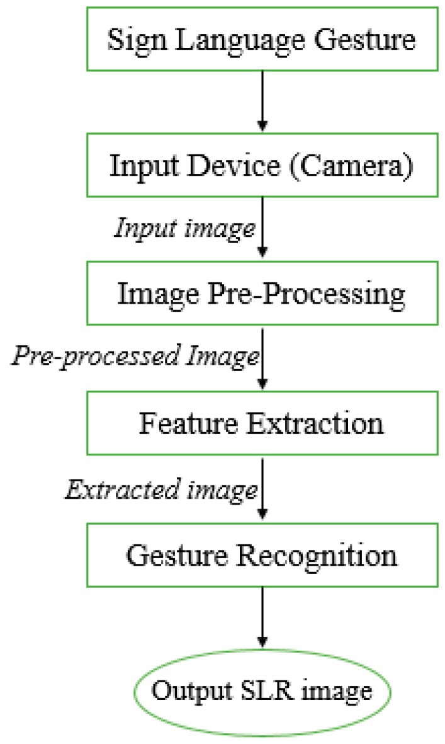
METHODOLOGY
Data Acquisition
Preprocessing
Feature Extraction
Gesture Recognition
Sign Language to Text Mapping
Display and Output

Slide 5
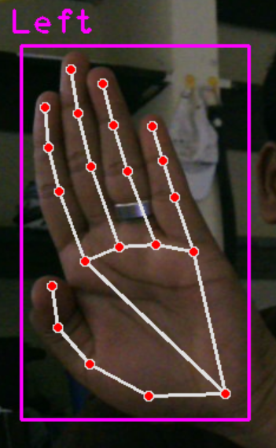
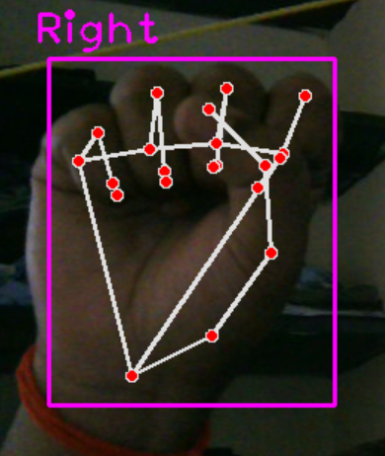
IMPLEMENTATION OF METHODOLOGY
1) Data Acquisition:
The aim is to capture hand/key-point data representing different sign language gestures and store it in a format that can be used to train a deep learning model.
We use MEDIAPIPE for real time hand tracking and extracting points. And we used OPENCV for capturing live video stream from webcam.

Slide 6
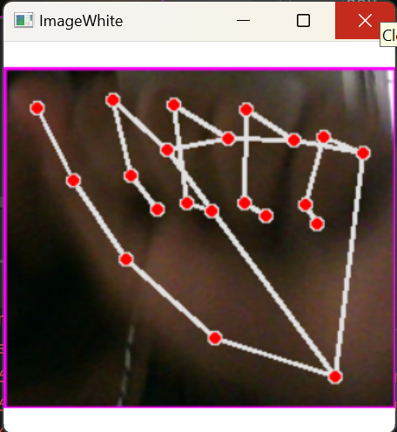
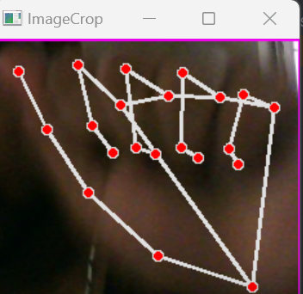
2) Preprocessing:
Convert webcam frames into “Image White” format. Cropping the hand area from the webcam feed. Optionally resize it and prepare it for model input.
3) Feature Extraction:
It’s a process of turning hand gestures into meaningful representations that can be fed into model for classification or recognition.
Dataset has been created for all the 26 alphabets.
Each alphabets contains minimum 300 images.
We created a directory path called “Data” which contains all the images that forms the Dataset creation.

Slide 7
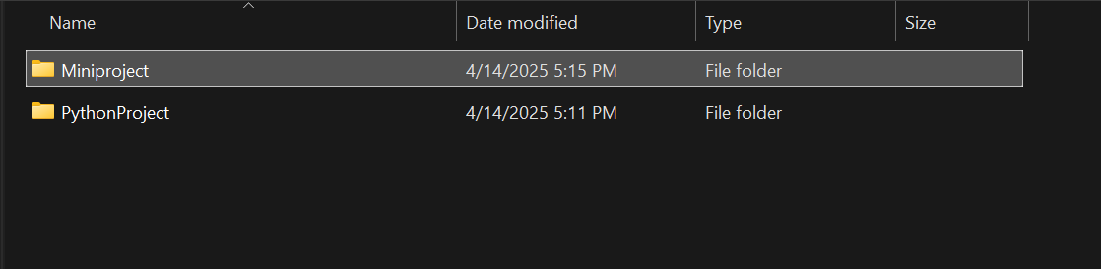
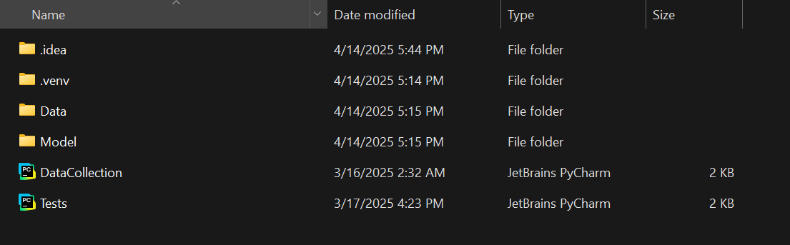
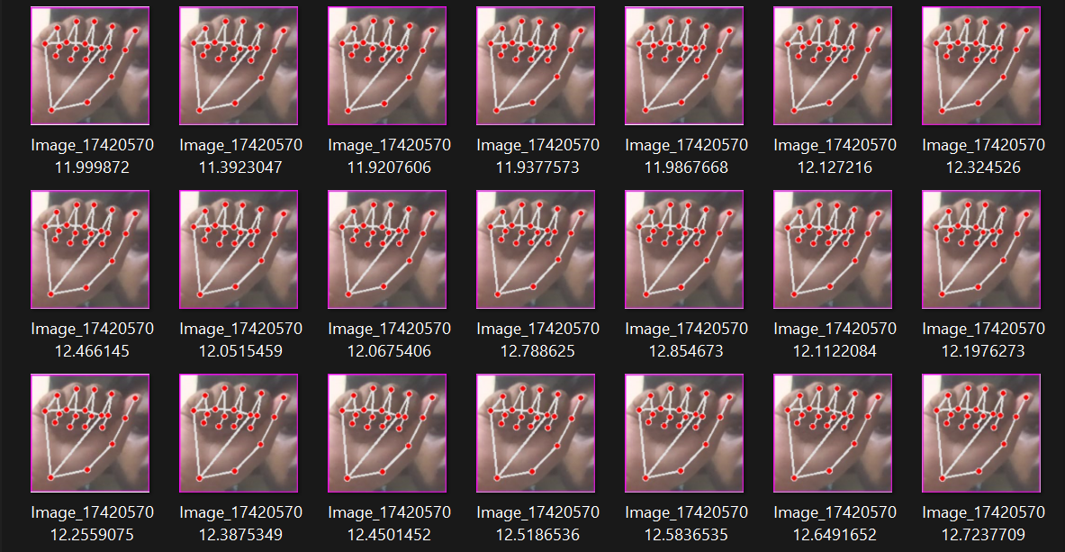
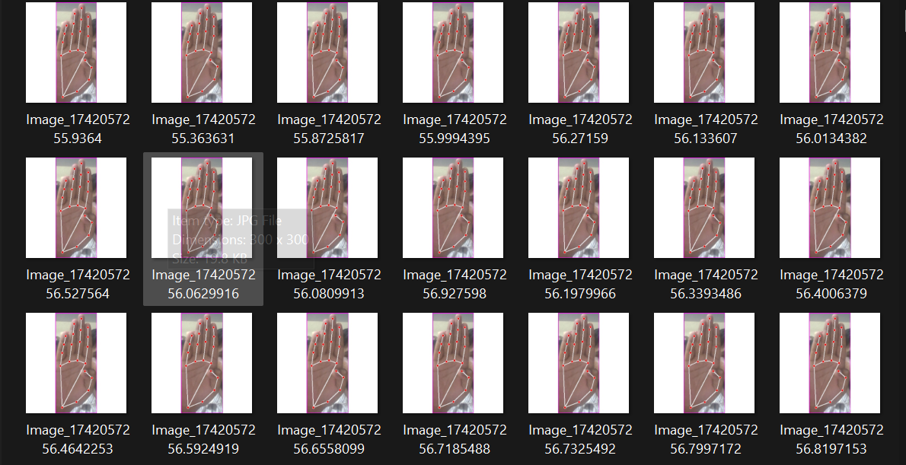
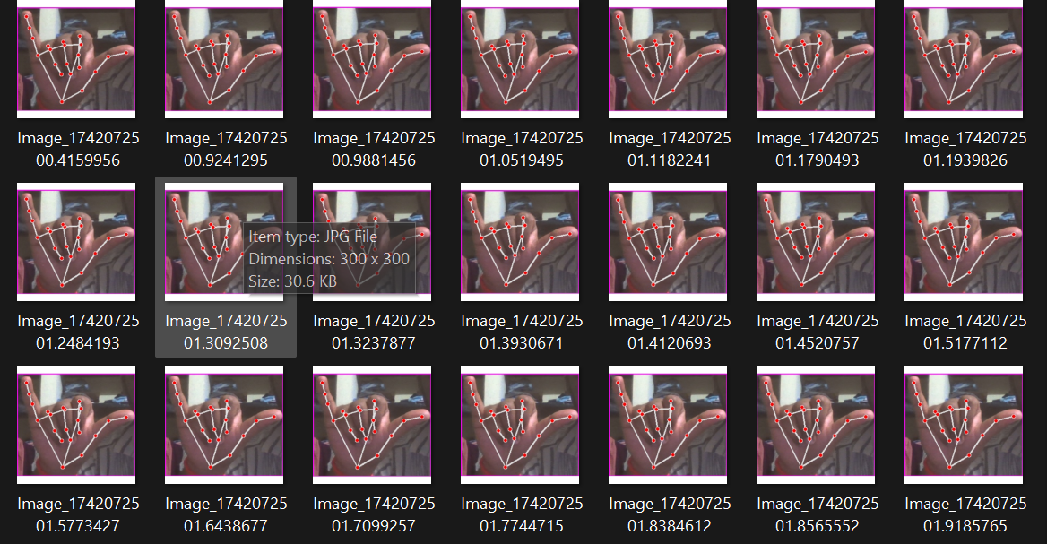

Slide 8
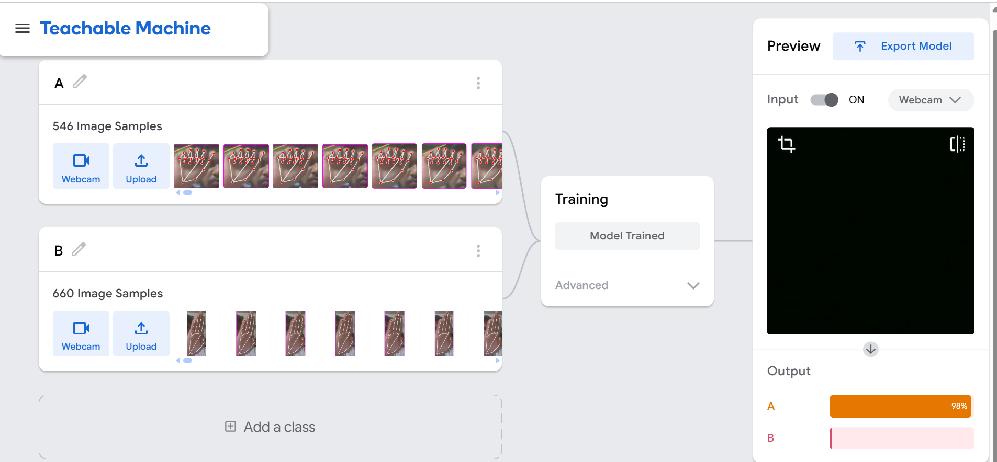
4) Gesture Recognition:
We used a website known as “Teachable Machine” which allows the users to create machine learning models without any code experience.
Steps Involved:
Collect and Label data: Use your webcam to gather images and label them.
Train the model: Click the Train button Teachable machine process your data and develop a model.
Test and Export: Evaluate your model’s performance and export it for use in projects.

Slide 9
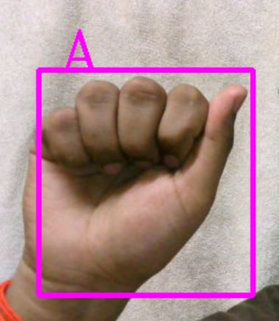
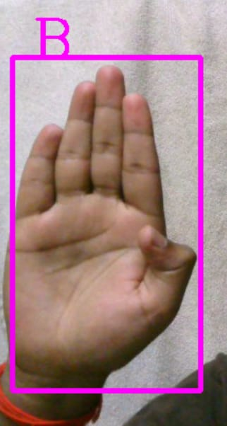
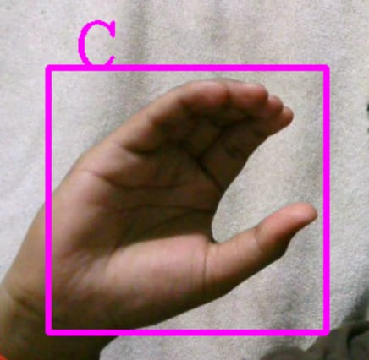
RESULTS:
Each recognized hand gesture or sign is converted into a letter and displayed on the screen.

Slide 10
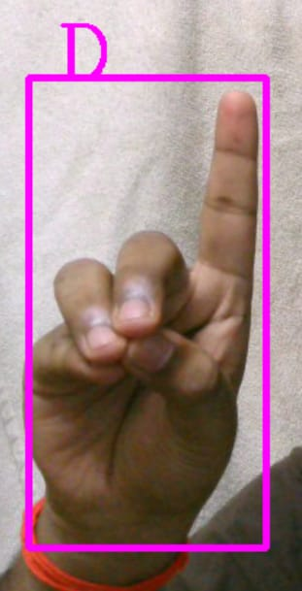
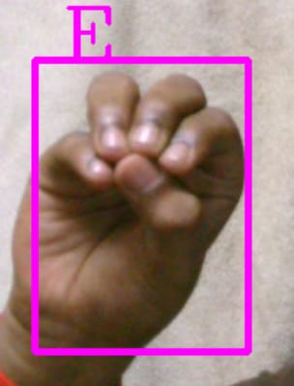
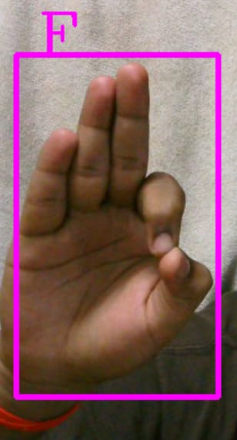

Slide 11
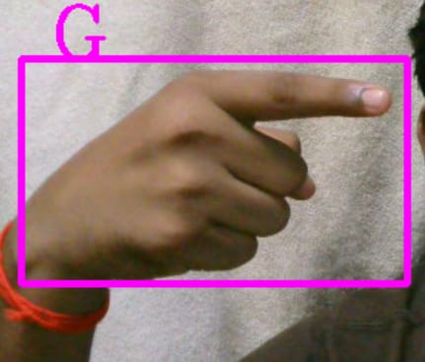
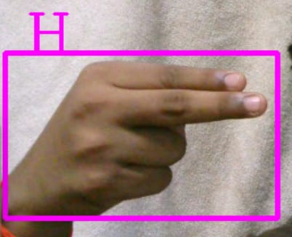
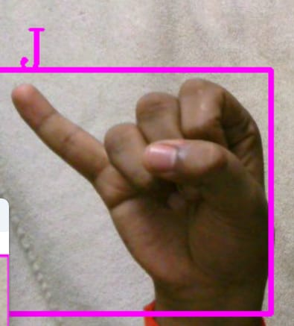

Slide 12
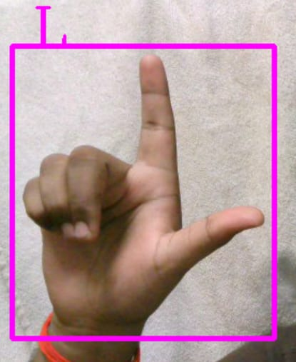
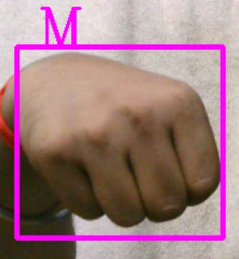
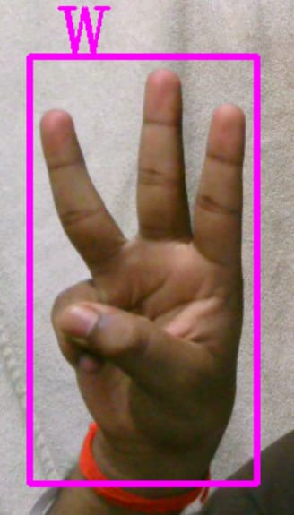

Slide 13
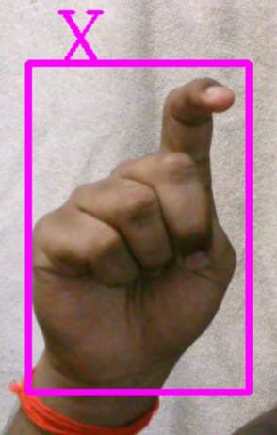
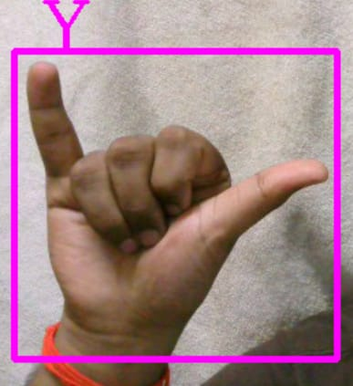
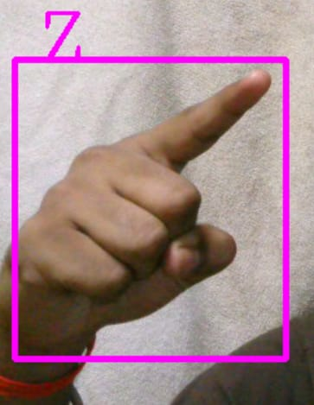

Slide 14
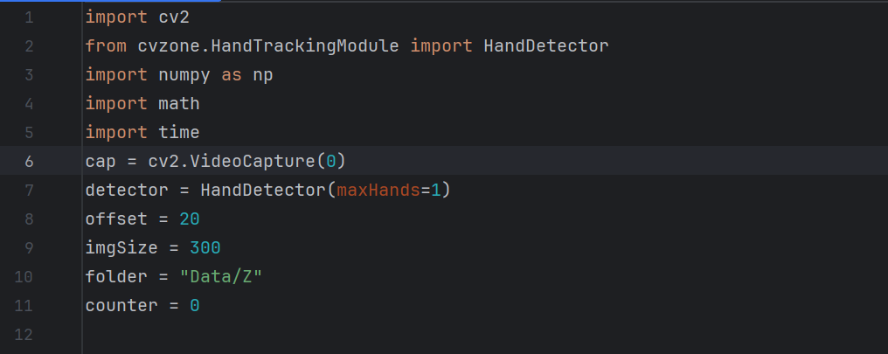
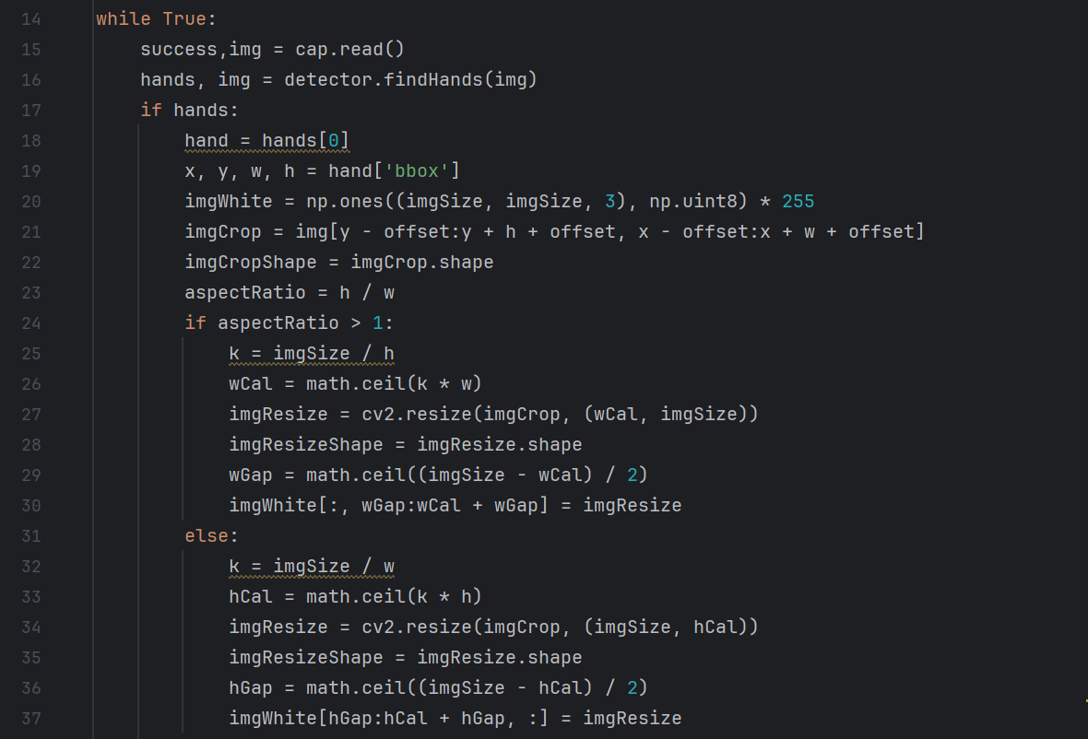
CODING STANDARDS:
Importing all the necessary library files such as OpenCV, numpy,math,Tensorflow,mediapipe and capturing live video stream from webcam.
Preprocessing the image into “image White” and “image Crop”

Slide 15
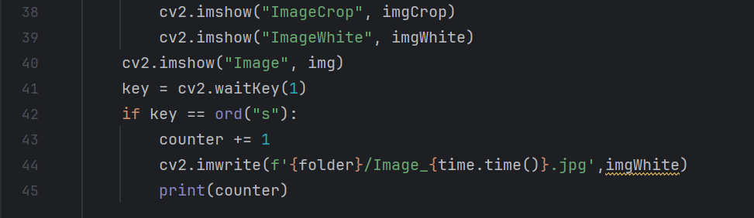
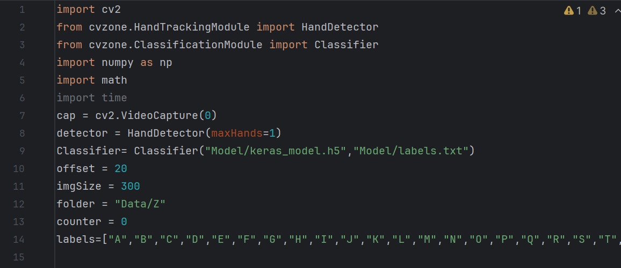
Displaying the Output after image processing. Key “S” is assigned to control the number of images taken to create the dataset.
Importing the extracted keras file which is trained by the teachable machine as a classifier. Labels are defined for the alphabets.

Slide 16
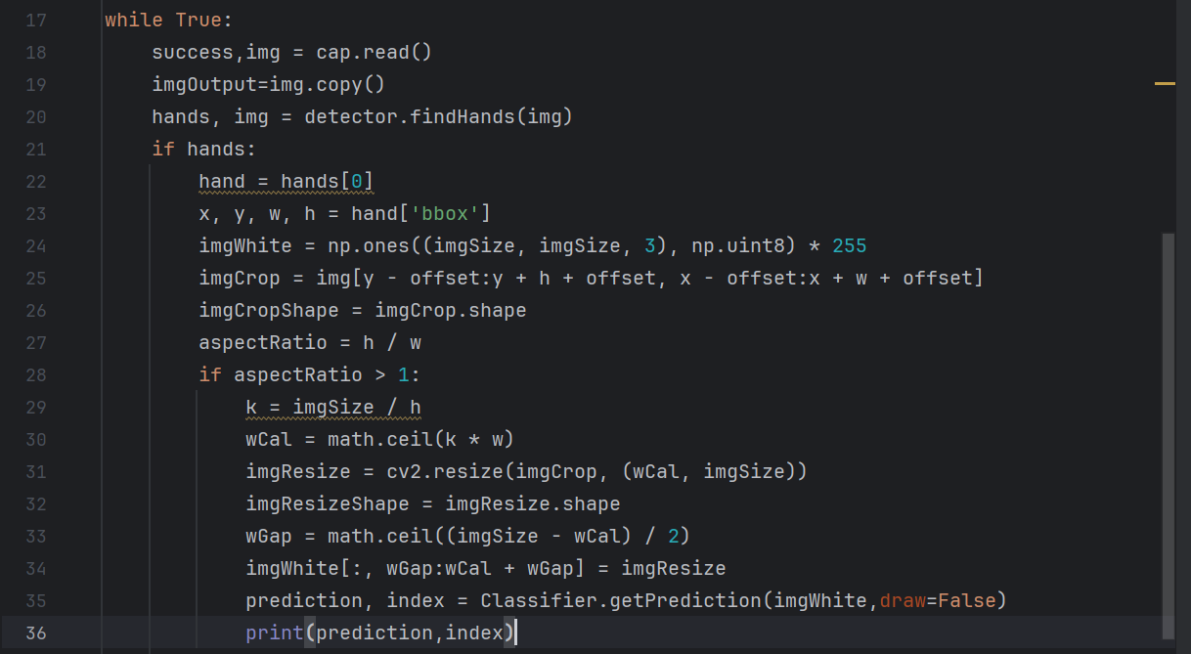
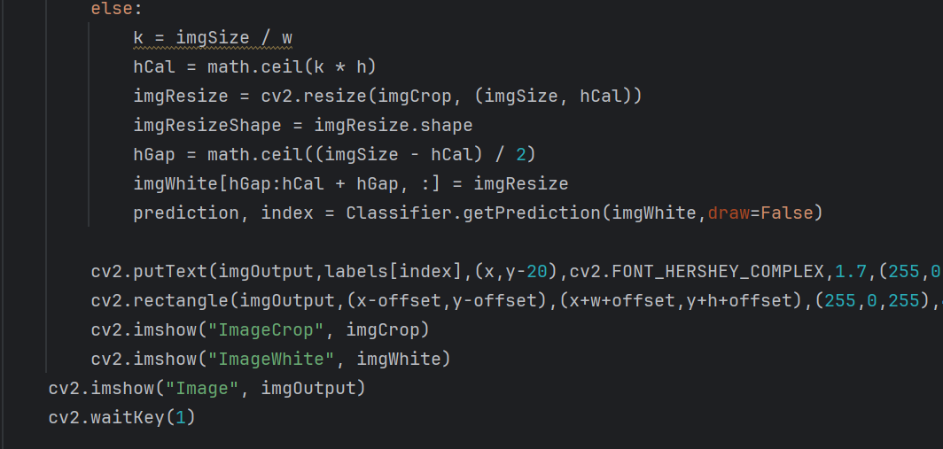
Detecting hand positions and movements to interpret and translate sign language gestures into text.
Using FONT_HERSHEY_COMPLEX for displaying the output (alphabetical letter).

Slide 17
INTERPRETATION
This project aims to bridge the communication gap between the hearing-impaired and non-signers by converting sign language gestures into readable text in real time. It leverages computer vision and deep learning to detect and classify hand gestures corresponding to alphabetic signs.
Tools Used:
Mediapipe - MediaPipe is used to track 21 hand landmarks per frame with high accuracy and speed.
OpenCV – Real time video capture and display.
NumPy - Handles numerical data like landmark coordinates, prepares input for the model.
TensorFlow/Keras - Builds and runs a deep learning model to classify signs based on landmark inputs.
Work To Be Done:
Increase the efficiency of the Output.
Display The output into a word or sentence.

Slide 18
TIMELINE
REVIEW | PLAN
0th Review | Identification of problem statement and exploring the components required.
1st Review | Hand gesture capture, Image processing and Feature processing.
2nd Review | Based on the matched gesture, the corresponding word would be displayed as text.

Slide 19
REFERENCES
Anuja V.Nair, Bindu, “A Review on Indian Sign Language Recognition”, International journal of computer applications, Vol. 73, pp: 22, (2013).
Archana S. Ghotkar, Rucha Khatal, Sanjana Khupase, Surbhi Asati & Mithila Hadap, “Hand Gesture Recognition for Indian Sign Language”, IEEE International Conference on Computer Communication and Informatics (lCCCI ), pp: 1-4, (2012).
Hu Peng, “Application Research on Face Detection Technology based on Open CV in Mobile Augmented Reality”, International Journal of Signal Processing, Image Processing Recognition, Vol. 8, No. 2 (2015). and Pattern Recognition, Vol.8. No.2 (2015)

Slide 20


